Slide 1

🤓 Live! Dev! Tool! Building an XrmToolBox Tool!
Jonas Rapp

Slide 2
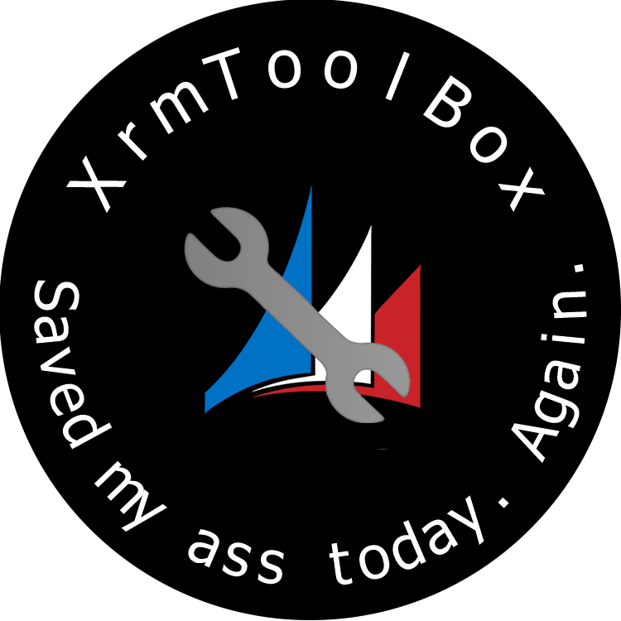

🤓 Live! Dev! Tool! Building an XrmToolBox Tool!
Jonas Rapp

Slide 3


















¡GRACIAS PATROCINADORES!
PLATINO
ORO
PLATA

Slide 4


Jonas Rapp
💖

Slide 5
Jonas Rapp
25
13
8
13
Notes:
25 plus years of consultant and development
13 years in the Dynamics CRM and Power Platform
8 years as creating XrmToolBox tool published
13 published tools

Slide 6


Slide 7
We will build…
Mini CRM
Why not?
Notes:
Because I can!

Slide 8
It isn’t hard.

Slide 9
We will see…
Template
Helpers
UI
Metadata
Data
Async

Slide 10
Links
JonasR.app
github.com/rappen/Bizz22

Slide 11
TACK! GRACIAS
@rappen

